Slide 1
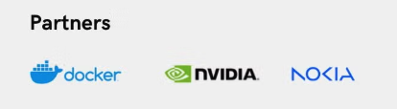
Fine-Tuning LLMs Locally with Nemo Framework and Deploy on NIM
Notes:
AI-generated content may be incorrect. --- This presentation aims to take you on a journey through the fascinating world of Generative AI, using Microsoft Azure AI Foundry as our practical platform. We will explore its theoretical foundations and demonstrate its applications in real-world scenarios.

Slide 2

About Me
Manjunath Janardhan, Principal Engineer at MSG Global
20+ years of software engineering experience
Key expertise areas: Gen AI Solutions, Microservices & Cloud
Patent Holder
Notes:
This slide serves as an introduction to my professional background and journey. I will cover my educational background, work experiences, and the skills I've developed. Additionally, I will share my interests and passions within the industry. The LinkedIn QR code will facilitate networking, and the portfolio link will provide insights into my work and projects.

Slide 3

Agenda Overview
Base Model and Instruction Tuned
NeMo Framework
Build Base SLM from Scratch using NeMo Framework: Walkthrough
SFT Fine Tunning of SLM Base model using NeMo Framework: Walkthrough
Live Demo: NIM
Q&A
Notes:
We'll begin with an introduction to Generative AI, covering its definition, historical context, and importance in modern technology. Next, we'll delve into the mechanics of how Generative AI works, followed by several practical demonstrations using Azure AI Foundry.

Slide 4
Base Model and Instruction Tuned
Base Models | Instruction Tuned | Organization
GPT 3.5 | ChatGPT 3.5 | OpenAI
Llama-3.2-1B | Llama-3.2-1B-Instruct | Meta
gemma-3-1b | gemma-3-1b-it | Google
phi-4 | Phi-4-mini-instruct | Microsoft
Hymba-1.5B-Base | Hymba-1.5B-Instruct | NVIDIA

Slide 5
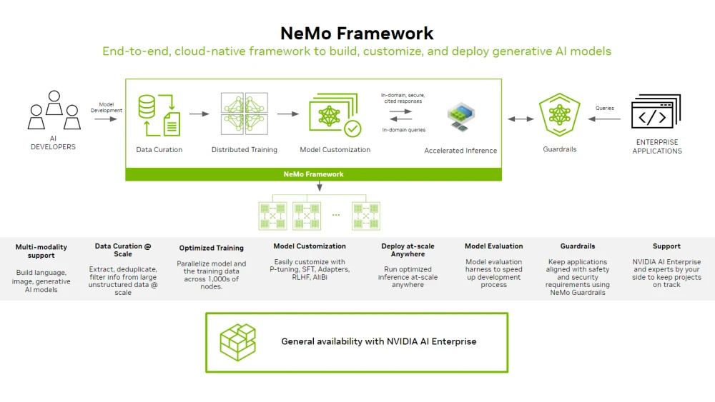

Slide 6

Build Base SLM from Scratch using NeMo Framework: Walkthrough

Slide 7
SFT Fine Tunning of SLM Base model using NeMo Framework: Walkthrough

Slide 8
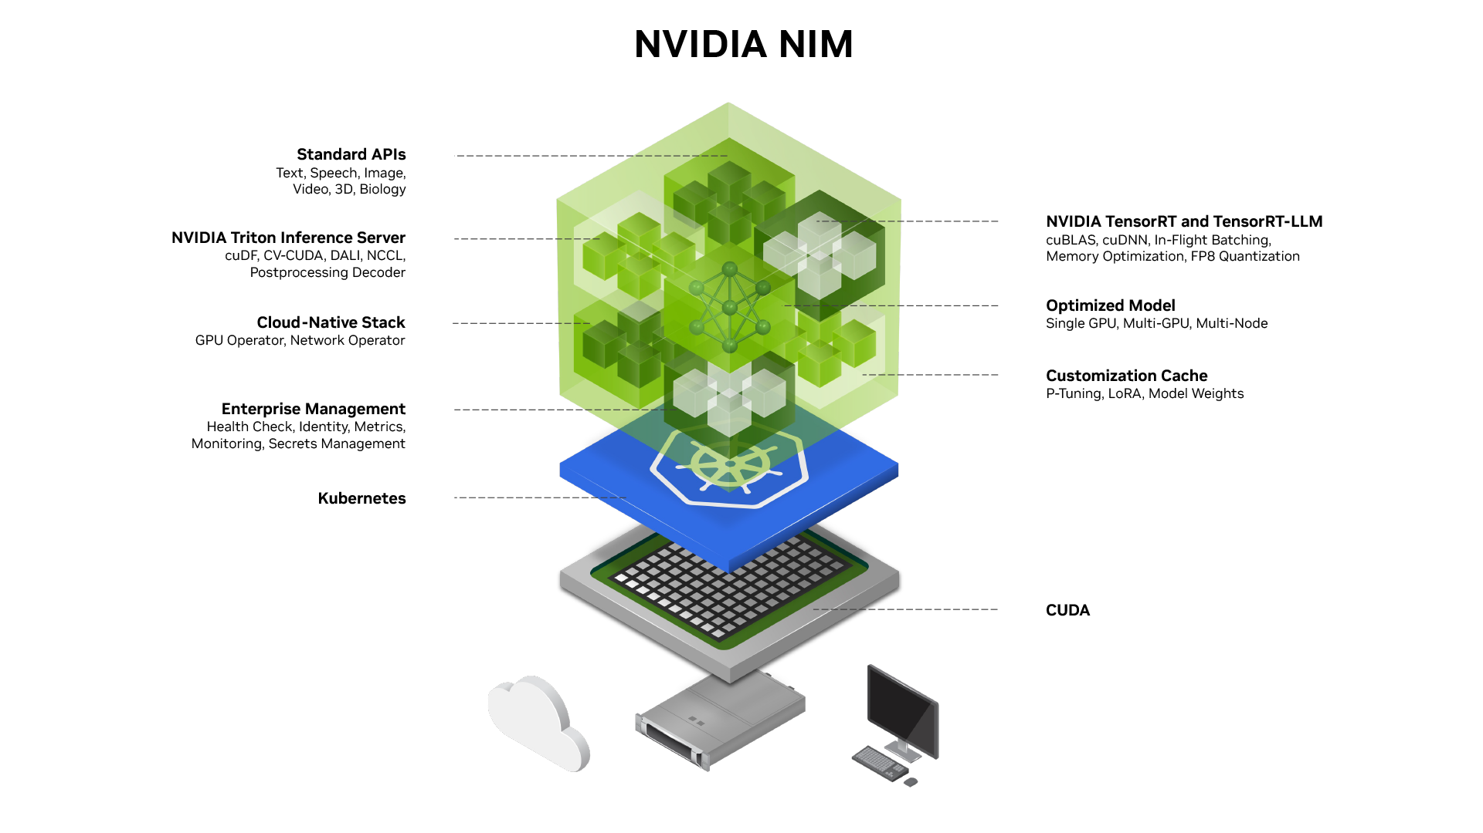
Live Demo

Slide 9
Resource
Example Note Book: https://bit.ly/NVIDIA-SFT
Deploy NIM: https://build.nvidia.com/meta/llama-3_1-8b-instruct/deploy
NGC API KEY : https://org.ngc.nvidia.com/setup
Lightning AI : https://lightning.ai/

Slide 10


